Slide 1
AlignRT Treatment Reports
Streamline your SGRT administration
Michael Niggli R.T. (R)(T)
Clinical Applications Specialist (NE Region)

Slide 2
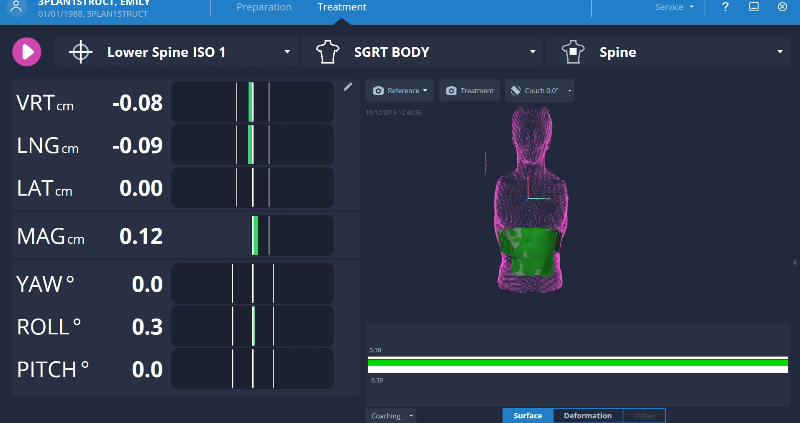

AlignRT From Start To Finish
Patient Setup (Pre-Treatment)
Active Motion Management- Intrafraction Monitoring (During Treatment)
Based on our usage data, 99% of people are using the system for both SETUP and ACTIVE MOTION MANAGEMENT
Rigid Registration 6DoF
setup & intra-fraction monitoring

Slide 3
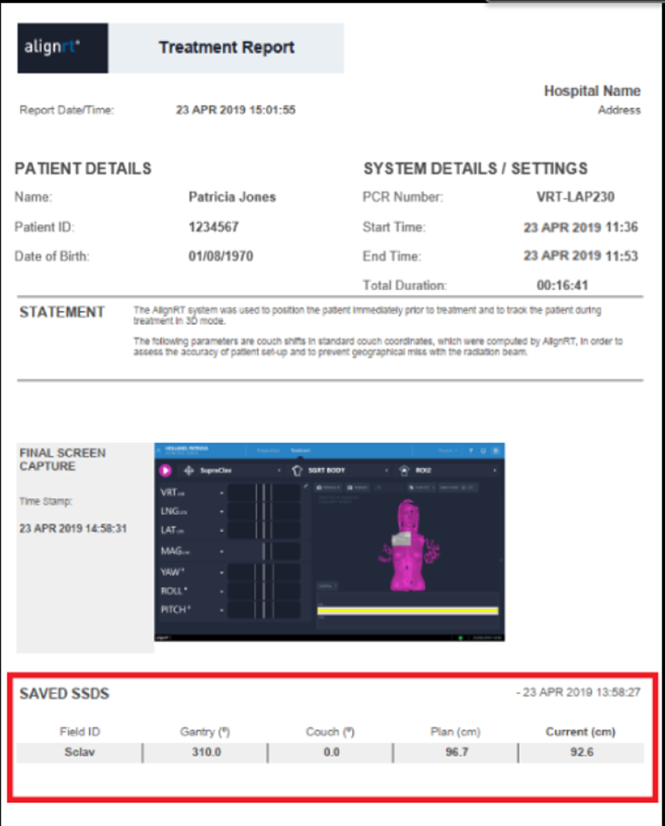

AlignRT Treatment Reports
AlignRT Treatment Reports are generated session reports created by the AlignRT (SGRT) system for each fraction.
They act as the paper trail that shows how the patient was positioned, monitored, and managed using surface guidance.
Why do we need them?
How are they created?
How can we configure these reports to include the information we need?
How do they ultimately end up in the patients EMR?

Slide 4
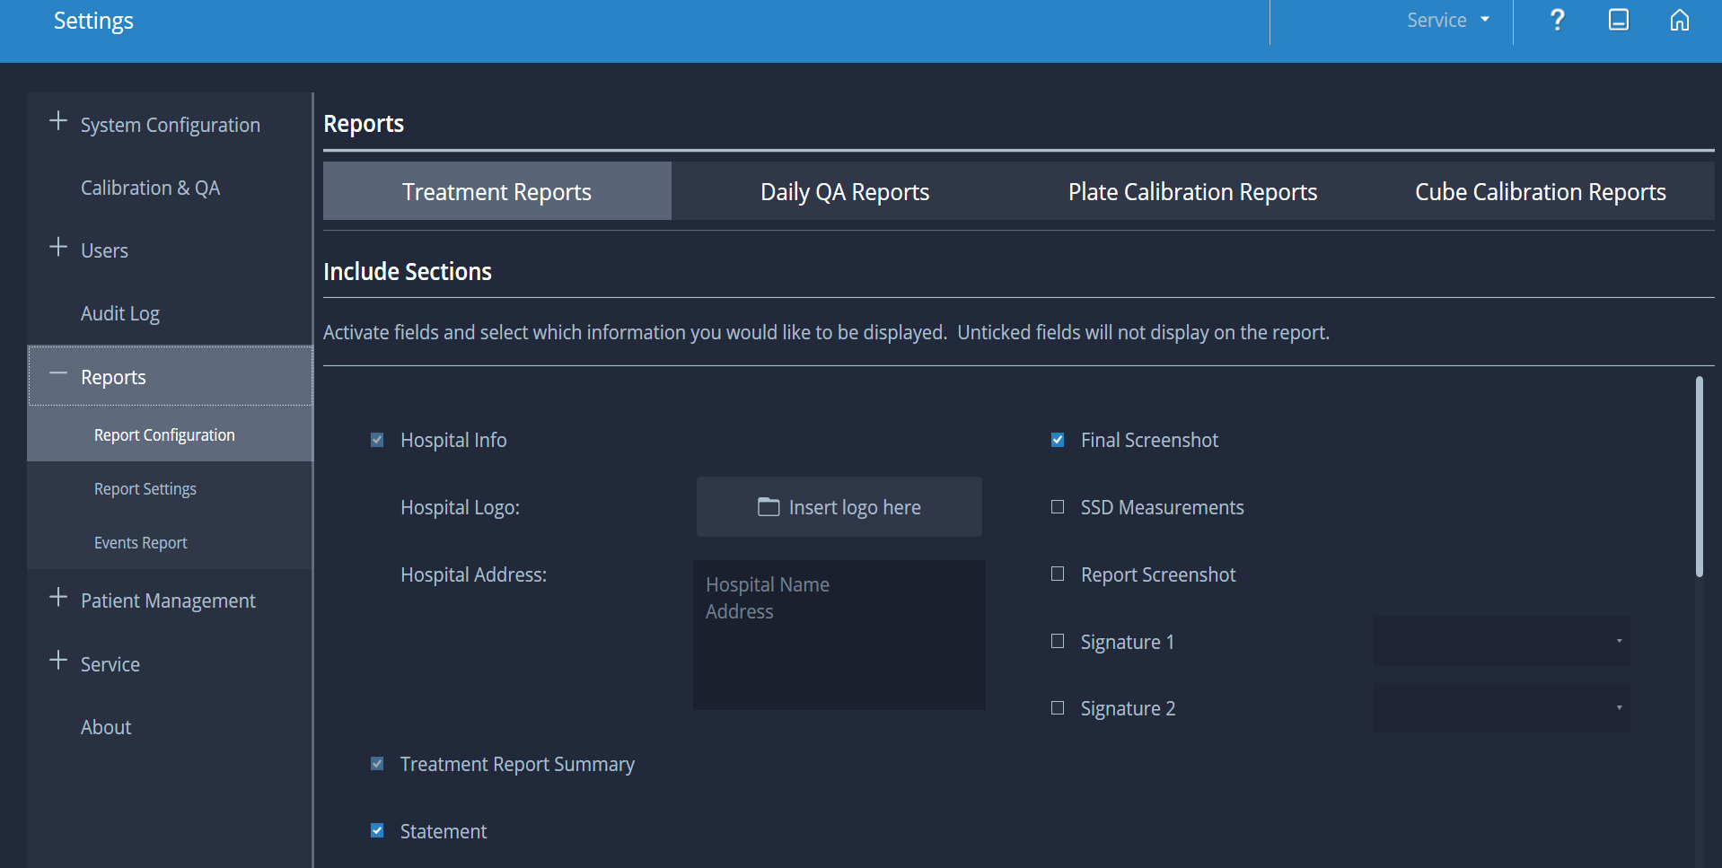
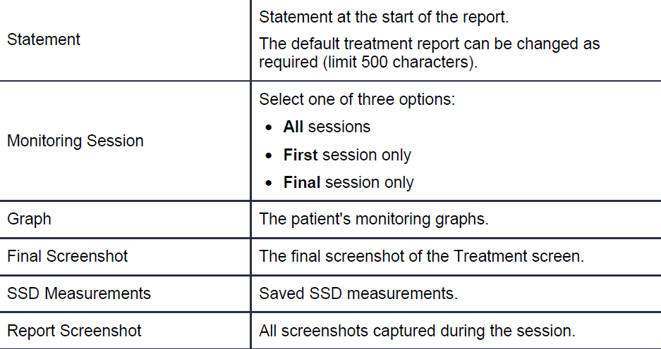
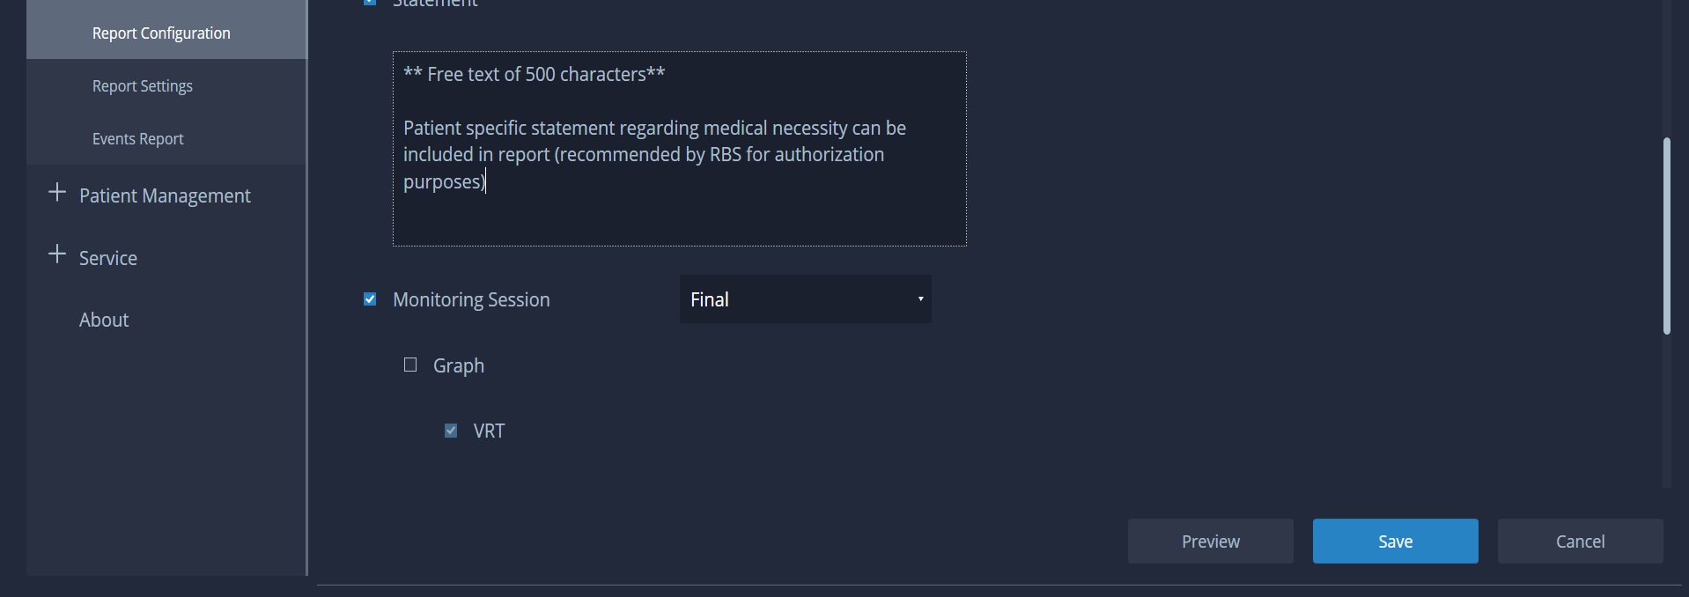

Treatment Report Configuration
The patient’s treatment report can include several pieces of critical information
Use the Reports configuration screen to define what is included in your reports.
The settings in the Templates are local (they apply to your system only).

Slide 5
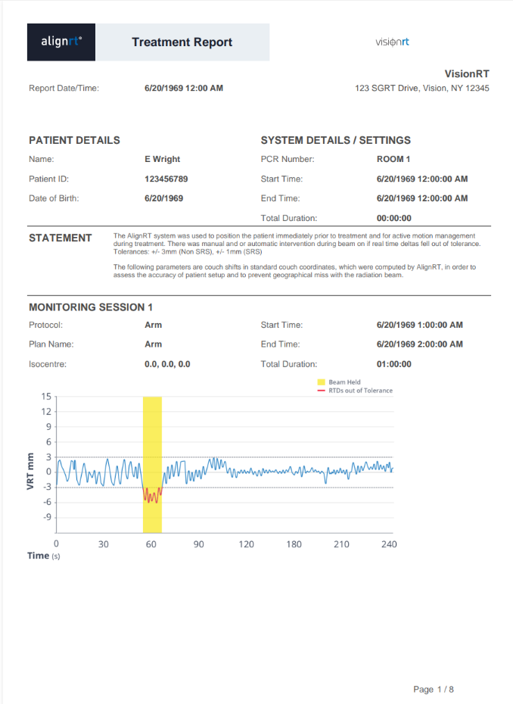
ASTRO AMM Model Policy Draft
Documentation must clearly support medical necessity and workflow transparency
Identify AMM method and technology used
  (e.g., system, gating, adaptive motion management)
Define monitoring parameters and tolerances
  Including out-of-tolerance thresholds and response
Describe motion tracking and review process
  How data is acquired, monitored, and communicated to staff
Specify beam control methodology
  Beam-on/beam-off criteria or adaptation logic
Demonstrate that treatment delivery is actively managed by motion data

Slide 6
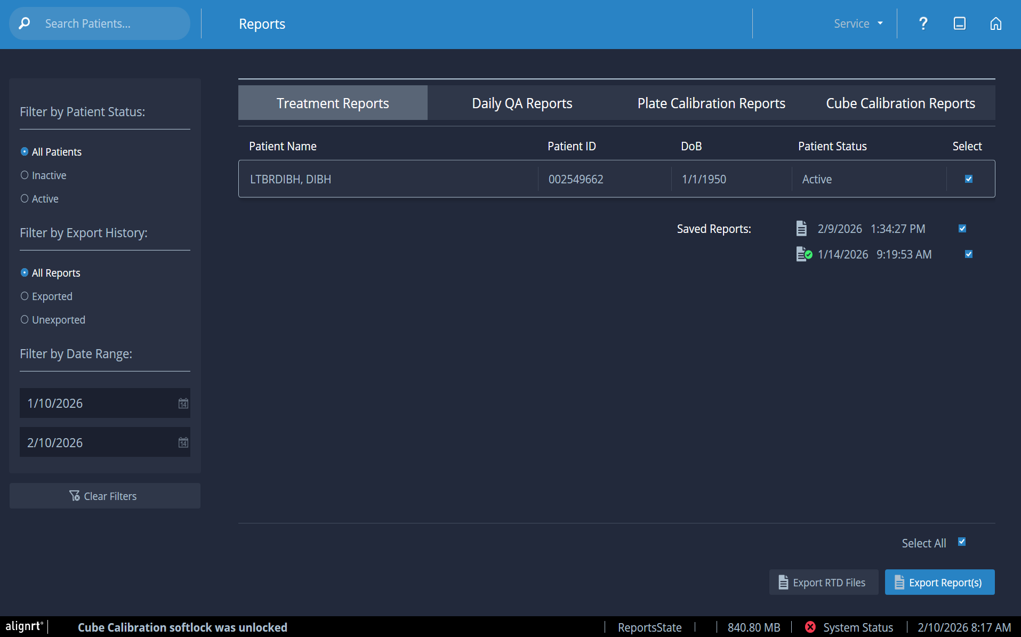
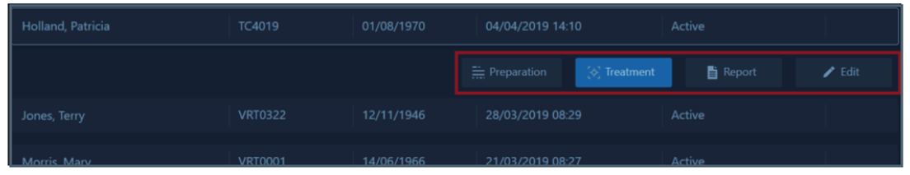
Exporting AlignRT Treatment Reports- Manual Process
Once configured, patients are filtered and listed alphabetically in the Reports browser under “Treatment Reports.”
If there are any reports for a patient, the Report button is enabled in the Patient Browser Tile.
When opening from the Patient Browser, this brings you back into the Reports Tile showing the selected patient with their treatment reports listed.
Select the patient and click Report.

Slide 7
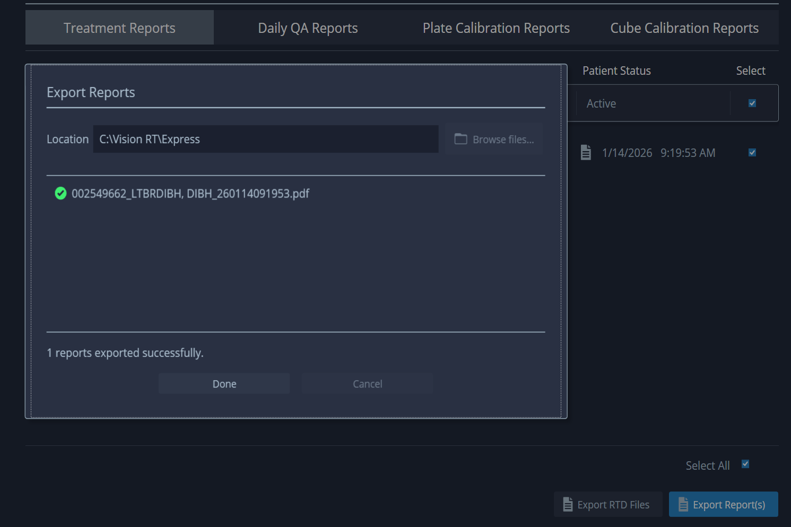
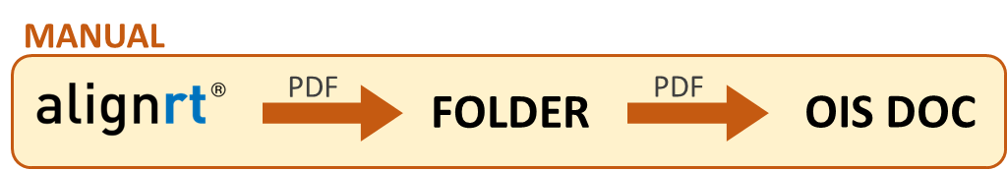
Treatment Report Auto-Export
Even when auto reporting is enabled, it’s difficult to receive appropriate access needed to configure the automation.
Because of this, retrieving AlignRT Treatment Reports becomes a manual process for most customers.
If your system is configured to automatically generate and export treatment reports, this will be done when a treatment session has ended. (No manual export necessary as shown on the last slide)
The icon beside the report indicates the status of exported files to your local drive.
Report is in a queue waiting to be exported
Export successful
Report has not been exported
Export unsuccessful

Slide 8
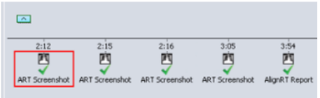
Avoid Manually Exporting Treatment Reports
Vision RT’s solution to automatic treatment reporting
Automates the transfer of AlignRT treatment reports directly into the OIS
Designed to support both:
Clinical quality documentation
Authorization and billing processes
Eliminates manual exporting, reduces clicks, and ensures consistent documentation across patients
turning SGRT documentation into a background process
OIS Reports Module

Slide 9

SGRT ACCESSIBILITY: Report/DATA Transfer
Pre-Version 6 AlignRT
MANUAL
PDF
FOLDER
PDF
OIS DOC
ARIA
TIMELINE
Version 6+ AlignRT (current)
AUTO
MANUAL
PDF
FOLDER
FOLDER
PDF
OIS DOC
ARIA
TIMELINE
AlignRT Automatic Report Export
Manual Transfer
* Aria is a trademark of Siemens.

Slide 10
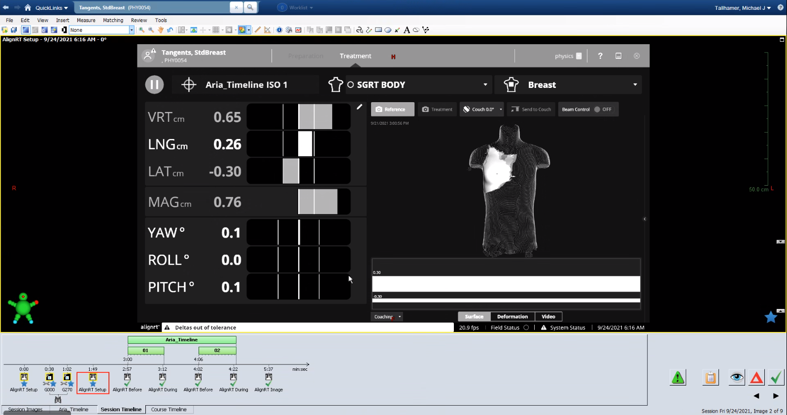
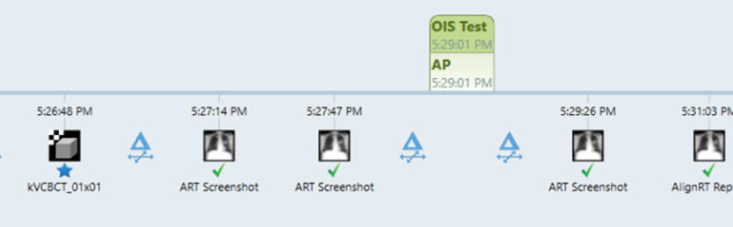
OIS REPORTS™ MODULE
A simple solution for SGRT admin:
Billing, Audit, Data Management
AUTO
DICOM
OIS / ARIA
TIMELINE
OIS Reports™ Module
“The OIS reports module automated our SGRT reporting process. Now we never miss an SGRT report, and the physician can review and approve them together with the IGRT daily review.”
Adi Robinson PhD DABR, AdventHealth Florida
Features
  Automated inclusion of SGRT use in OIS chart (AlignRT Screenshot/Reports)
  No manual input (initial setup <45 min)
  Compatible with Aria® and MOSAIQ®
Benefits
  Automated record keeping in one place, for audit and billing
  Eliminate separate SGRT data archive
  Record of final patient position (may eliminate post-Tx CBCT verification)
OIS REPORTS
Example implementations with Aria OIS
*Aria is a trademark of Siemens. MOSAIQ is a trademark of Elekta

Slide 11

Frequently Asked Questions
What about our firewall / cybersecurity?
  An exception is needed for the specific IP address
What type of program is OIS reports?
  Windows service – it doesn’t need to be started every computer restart
What patient data is stored by the program?
  None – not even patient ID. Data is taken directly from the folder into the OIS.
What if the server is disconnected when the AlignRT report is saved?
  OIS Reports continues to try to save whenever connectivity is restored.
What documentation is supplied for our IT team?
  An 8-page briefing (mostly pictures) step-by-step guide to setup for Aria / MOSAIQ.
How do you get the report from AlignRT?
  Using auto export or manual export from AlignRT.
What if you only want some patient reports in OIS?
  We recommend doing manual export.
Is the price per linac or per OIS?
  Price is per AlignRT system, with no limit on number of systems.
How is AlignRT impacted?
  The module is installed outside of AlignRT. No changes are made to AlignRT, but customers may want to enable auto export of treatment reports so all reports are automatically sent.
Our team is available 24/7 to address any questions regarding AlignRT Treatment Reports and OIS Reports Module

Slide 12
Questions
Thank you for attending

